Slide 1
Machine Learning, Deep Learning, and Security.

Slide 2

1.1.1 Artificial Intelligence
Refers to the simulation of human intelligence
1. Machine Learning (ML).
Mimicking the intelligence or behavioral pattern of humans or any other living entity.
تقليد نمط الذكاء أو السلوك البشري أو أي كائن حي اخر.
Artificial Intelligence

Slide 3
What is ML?

Slide 4
Machine learning
تعلــــــــــــــــــــــــــــم الالــــــــــة
ML Enables computers to learn from data
ML is a branch of artificial intelligence (AI) that allows computers to automatically learn from data.
A technique by which a computer can “learn” from data without using a complex set of rules.
Mainly based on training a model from datasets.
Artificial Intelligence
Machine Learning is the field of study that gives computers the ability to learn without being explicitly programmed.
Arthur Samuel, 1959
Machine Learning
ML teaches the systems to think and understand like humans by learning from the data.

Slide 5
Machine learning تعلــــــــــــــــــــــــــــم الالــــــــــة
An algorithm is a set of mathematical instructions or rules that directs a computer program to solve a specific problem or perform a task.
In machine learning, an algorithm enables a model to process data, identify patterns, and make predictions.
Figure 1.1 The meaning of machine learning.

Slide 6
Machine learning تعلــــــــــــــــــــــــــــم الالــــــــــة
How does ML work ?
1- ML algorithm is trained using a training dataset to create a model.
2- When new input data is introduced to the ML algorithm, it makes a prediction on the basis of the model.
3- The prediction is evaluated for accuracy, and if the accuracy is acceptable, the ML algorithm is deployed.
4- If the accuracy is not acceptable, the ML algorithm is trained again with an augmented raining data set.

Slide 7
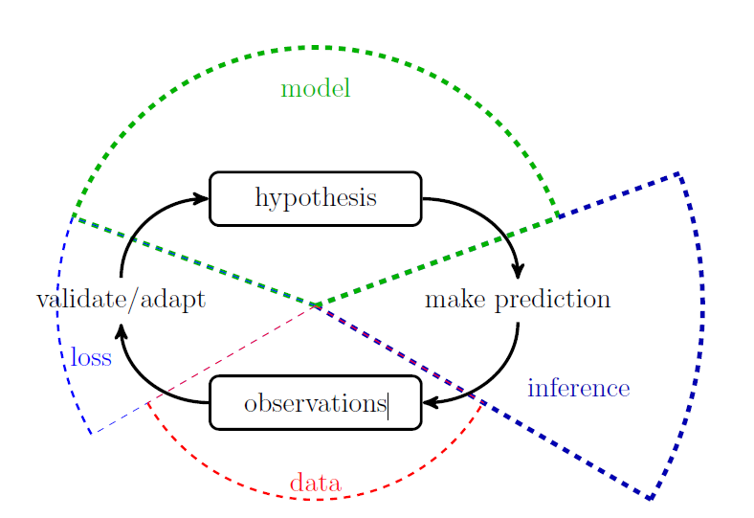
Machine learning تعلــــــــــــــــــــــــــــم الالــــــــــة
Machine learning combines three main components: model, data and loss.
Machine learning methods implement the scientific principle of \trial and error.
These methods continuously validate and refine a model based on the loss incurred by its predictions about a phenomenon that generates data.

Slide 8
Real-World Applications of Machine Learning
Machine Learning is widely being applied and used in the real world today to solve complex problems that would otherwise have been impossible to solve based on traditional approaches and rule-based systems.
The following list depicts some of the real-world applications of Machine Learning.
• Product recommendations in online shopping platforms
• Sentiment and emotion analysis
• Anomaly detection
• Fraud detection and prevention
• Content recommendation (news, music, movies, and so on)
• Weather forecasting
• Stock market forecasting
• Market basket analysis
• Customer segmentation
• Object and scene recognition in images and video
• Speech recognition
• Churn analytics
• Click through predictions
• Failure/defect detection and prevention
• E-mail spam filtering

Slide 9
Machine learning تعلــــــــــــــــــــــــــــم الالــــــــــة
Main Challenges of Machine Learning
Since your main task is to select a learning algorithm and train it on some data, the two things that can go wrong are “bad algorithm” and “bad data.”
Insufficient Quantity of Training Data : كمية بيانات التدريب غير كافية
The Unreasonable Effectiveness of Data: فعالية البيانات غير المعقولة
Nonrepresentative Training Data: بيانات تدريب غير تمثيلية
Poor-Quality Data. بيانات رديئة الجودة
Irrelevant Features. ميزات غير ذات صلة
Overfitting the Training Data الإفراط في ملاءمة بيانات التدريب
Underfitting the Training Data عدم ملاءمة بيانات التدريب

Slide 10
Necessary tools for practicing Machine Learning on your own data.
To practice machine learning on your own data, you'll need a few essential tools and libraries.
1. Programming Language: Python
Python is the go-to language for most machine learning tasks. It has a rich ecosystem of libraries,
frameworks, and community support.
2. Development Environment
IDE/Code Editor: You can use tools like:
  Jupyter Notebook (great for experimentation and visualization)
  VSCode or PyCharm (ideal for larger projects)
  Google Colab (cloud-based and free, no setup required)
Python Environment Management:
  Anaconda (for managing Python environments and packages easily)
  Virtualenv or Conda (to create isolated environments)

Slide 11
3. Libraries and Frameworks
You’ll need the following libraries for preprocessing data, building models, and evaluating them:
a) Data Handling & Processing
Pandas: For handling structured data (like CSV, Excel files, databases)
NumPy: For numerical operations and arrays
Scikit-learn: A powerful library for standard machine learning tasks (classification, regression, clustering, etc.)
Matplotlib/Seaborn: For data visualization and plotting
OpenCV: For image processing tasks (if you're working with image data)
b) Deep Learning
TensorFlow or Keras: For building neural networks and deep learning models.
PyTorch: Another popular deep learning framework, known for dynamic computation graphs.
c) Model Evaluation & Validation
Scikit-learn: Also provides tools for model evaluation (cross-validation, accuracy, precision, recall, etc.)
XGBoost or LightGBM: For gradient boosting models, which perform well in structured/tabular data tasks.
d) Data Augmentation & Preprocessing (for specific data types)
Augmentor or ImageDataGenerator (for image data augmentation)
NLTK or SpaCy (for Natural Language Processing tasks)

Slide 12
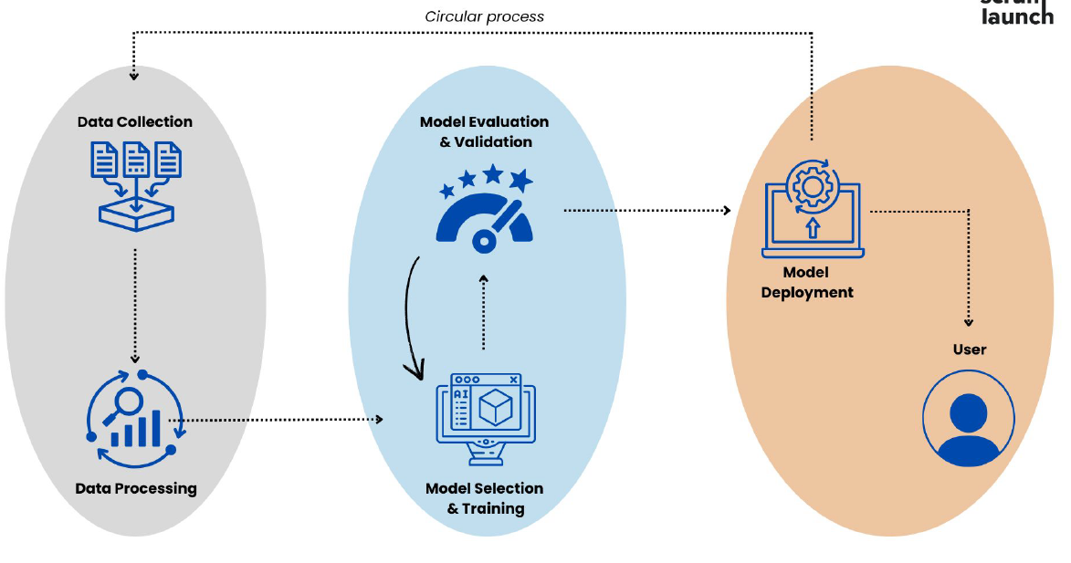
Machine Learning workflow steps

Slide 13
1. Data Collection & Preprocessing
Data collection and processing are essential parts of the ML process. They will determine how precise and effective the model will be.
Step 1: Data collection
The first step in the machine learning process is data collection. Data is the lifeblood of machine learning - the quality and quantity of your data can directly impact your model's performance. Data can be collected from various sources such as databases, text files, images, audio files, or even scraped from the web.
Once collected, the data needs to be prepared for machine learning. This process involves organizing the data in a suitable format, such as a CSV file or a database, and ensuring that the data is relevant to the problem you're trying to solve.
CSV (Comma Separated Values)

Slide 14


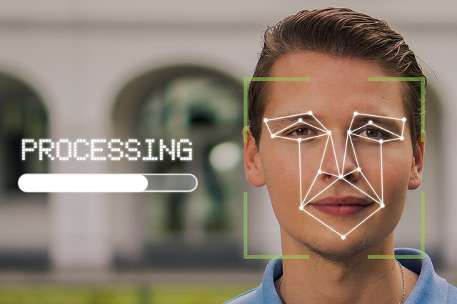

Fingerprints.
Handwriting,

Slide 15
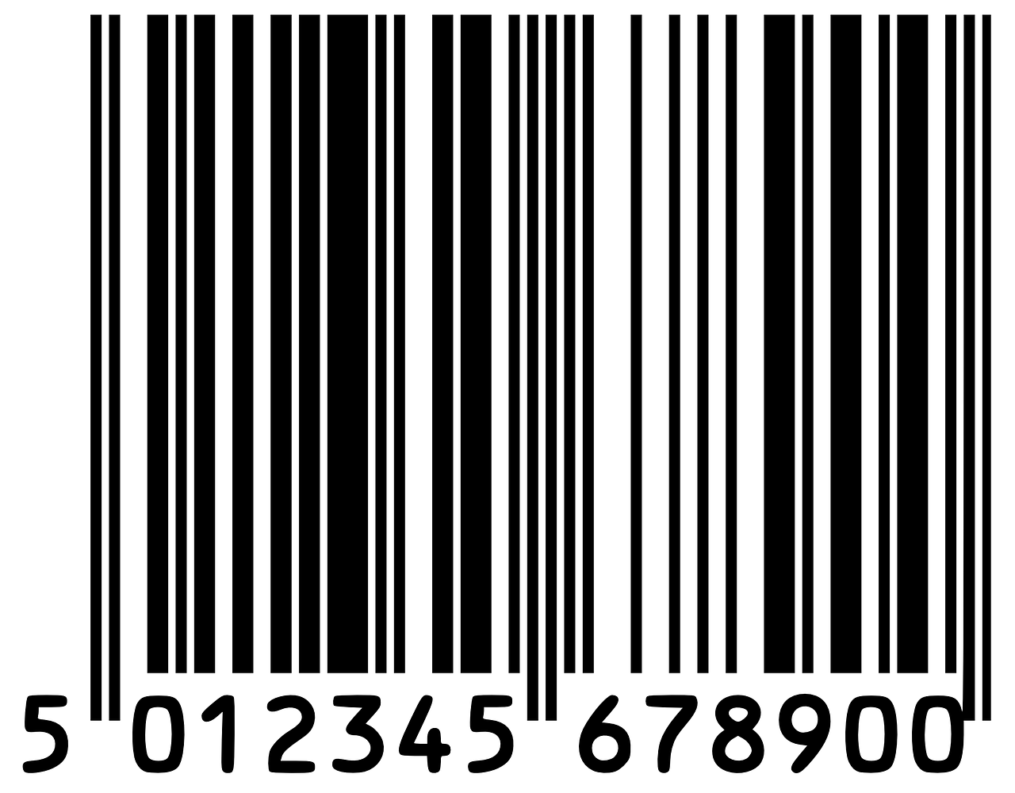
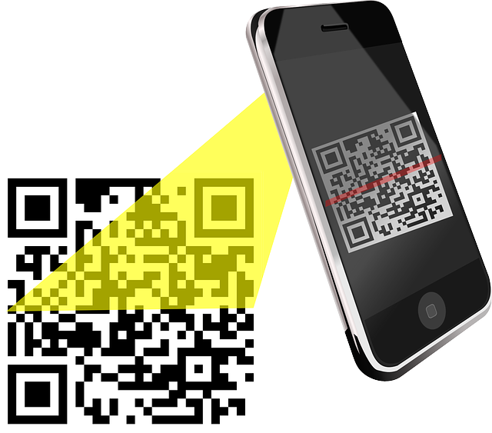
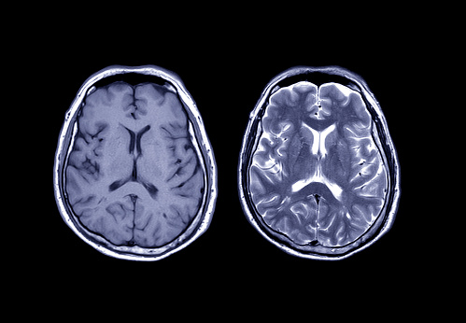

Slide 16
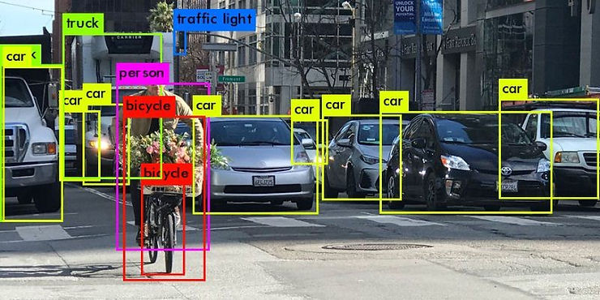

Slide 17
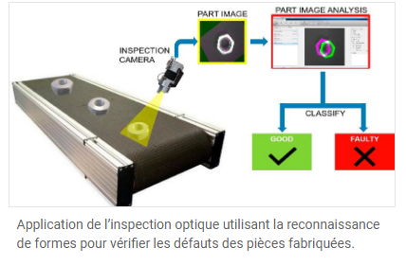

Slide 18
Step 2: Data preprocessing
Data preprocessing is a crucial step in the machine learning process. It involves cleaning the data (removing duplicates, correcting errors), handling missing data (either by removing it or filling it in), and normalizing the data (scaling the data to a standard format).
Preprocessing improves the quality of your data and ensures that your machine learning model can interpret it correctly.
This step can significantly improve the accuracy of your model.

Slide 19
Data preprocessing
Data preprocessing follows data collection and involves preparing the data for training the model. It consists of numerous crucial processes:
Data cleaning
Data transformation: Data transformation ensures that the data obtained is in an easily handled format to analyze. It may include:
1. Normalization
2. Encoding categorical features is done by converting such features into a numerical form that
machine learning algorithms can process.
Data augmentation: Data augmentation techniques can be used to increase the size and diversity of a data set. This is especially useful when data is limited, such as in image or text classification tasks. Generating additional data points from existing data can make the model more reliable and generalizable.
In summary, the data collection and processing phase is crucial for laying the groundwork for successful machine learning projects. By focusing on clear objectives, identifying quality data sources, and implementing robust processing techniques, you can significantly enhance the performance and reliability of your ML models.

Slide 20
Step 3. Model Selection, Training & Validation
Model training, testing, and evaluation are the next steps in the machine learning process, which focuses on developing an accurate model to solve a specific problem. This stage involves selecting a suitable algorithm, training the model on the prepared data, and thoroughly evaluating its performance.
Choosing a model: The first step is to understand the nature of your problem.
Is it about sorting things into categories (classification), predicting numbers (regression), or grouping similar items (clustering)?
Determining the type of issue helps in choosing the right candidate models. Using your domain knowledge, you can identify proven effective models for similar tasks. The most common options include:
- Linear models.
- Tree models.
- Neural networks.

Slide 21
Step 4: Training the model
After choosing a model, the next step is to train it using the prepared data. Training involves feeding the data into the model and allowing it to adjust its internal parameters to better predict the output.
During training, it's important to avoid overfitting (where the model performs well on the training data but poorly on new data) and underfitting (where the model performs poorly on both the training data and new data).
Step 5: Evaluating the model
Once a model is trained, evaluating its performance on unseen data is essential before deployment. Common metrics for evaluating a model's performance include accuracy (for classification problems), precision and recall (for binary classification problems), and mean squared error (for regression problems).

Slide 22
Step 6: Hyperparameter tuning and optimization
Hyperparameter tuning is the process of selecting the optimal values for a machine learning model's hyperparameters. These are typically set before the actual training process begins and control aspects of the learning process itself. They influence the model's performance its complexity and how fast it learns.
Step 7: Predictions and deployment
Deploying a machine learning model involves integrating it into a production environment, where it can deliver real-time predictions or insights. MLOps (Machine Learning Operations) has emerged as a standard practice to streamline this process. It encompasses version control, monitoring, and automated testing to ensure models are reproducible, reliable, and robust. MLOps frameworks like MLflow or Kubeflow support these goals by providing seamless workflows for deployment, retraining, and model rollback if issues arise.

Slide 23
Example Workflow:
Data Collection/Preprocessing: Use Pandas and NumPy for data cleaning and preparation.
Exploratory Data Analysis (EDA): Visualize the data with Matplotlib/Seaborn.
Model Building: Use Scikit-learn, TensorFlow, or PyTorch.
Model Evaluation: Validate the model using Scikit-learn’s metrics.
Hyperparameter Tuning: Use grid search or randomized search for hyperparameter tuning.
Deployment: Use Flask/Docker for API-based deployment or cloud services for scaling.

Slide 24
Understanding Input and Attributes in Machine Learning
In machine learning, the concept of “input” refers to the data provided to the model to analyze and learn from. Inputs are the essential building blocks of machine learning models, as they represent the features or attributes of each data point that the model uses to make predictions or classifications.
Attributes or features are the characteristics or properties of the data. In a dataset, each row represents an instance (or example), and each column represents a feature of that instance.
Characteristics of Features
Measurable: Features are quantifiable properties that can be measured and recorded.
Independent: Each feature should ideally be independent of the others, providing unique information to the model.
Varied Types: Features can be numerical (e.g., age, height), categorical (e.g., gender, color), or even text-based (e.g., reviews, comments).

Slide 25
Features |  |  | Label
Temperature | Humidity | Pressure | Test score
15 | 47 | 998 | Good
19 | 34 | 1020 | Excellent
18 | 92 | 1012 | Poor

Slide 27
What is Data Visualization and Why is It Important?
Data visualization is an important aspect of machine learning (ML) as it helps to analyze and communicate patterns, trends, and insights in the data. Data visualization involves creating graphical representations of the data, which can help to identify patterns and relationships that may not be apparent from the raw data.
Data visualization uses charts, graphs and maps to present information clearly and simply. It turns complex data into visuals that are easy to understand.

Slide 28
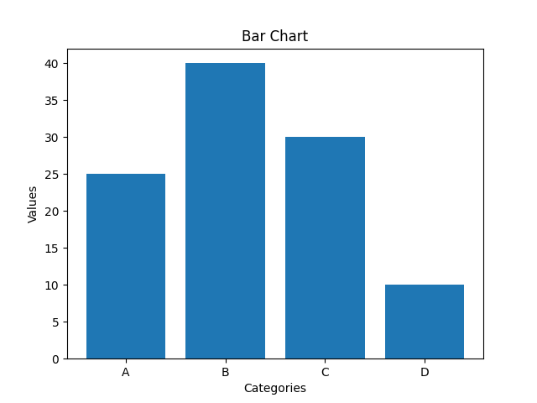
Types of Data Visualization Charts
1. Bar Charts
Bar charts are used to compare values across different categories using rectangular bars. X-axis shows categories while Y-axis represents values. Common types include horizontal, stacked and grouped bar charts.

Slide 29
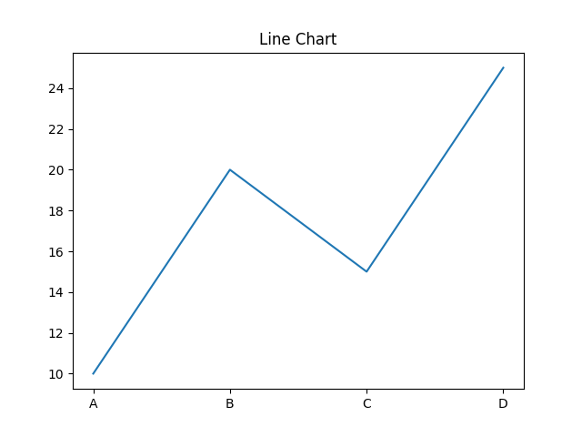
2. Line Charts
Line charts show how values change over time by connecting data points with lines. They help visualize trends like increases, decreases or stability.

Slide 30
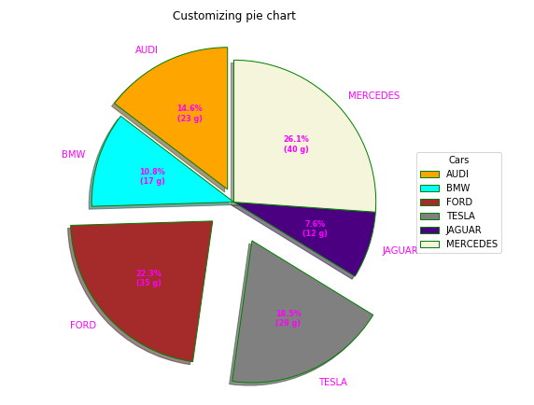
3. Pie Charts
Pie charts are round charts divided into slices, where each slice shows a part of the whole. The size of each slice represents its percentage.

Slide 31
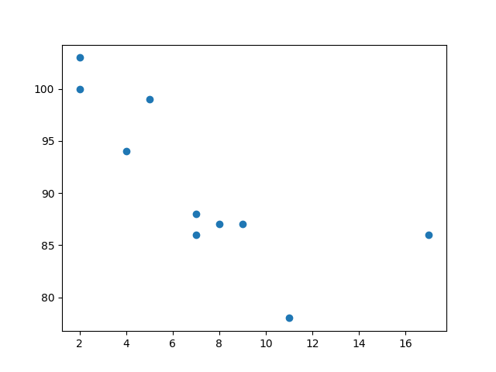
4. Scatter Chart (Plots)
Scatter charts use dots to show relationship between two numerical variables. X-axis shows the independent variable and Y-axis shows the dependent variable.

Slide 32
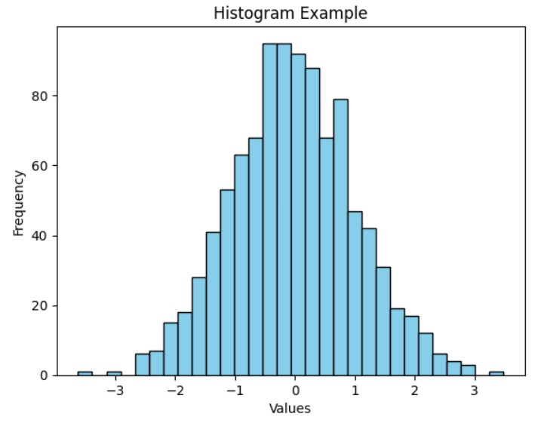
5. ﻿Histogram
A histogram displays the distribution of numerical data by grouping values into intervals (bins) and showing their frequency as bars. It helps reveal the shape, spread and patterns in the data.

Slide 33
Terminology
Sample (Observation or Data): item to process (e.g., classify).
Example: an individual, a document, a picture, a sound, a video. . .
Features (Input): set of distinct traits that can be used to describe each sample in a quantitative manner. Represented as a multi-dimensional vector usually denoted by x. Example: size, weight, citizenship, . . .
Label (Output): The class or outcome assigned to a sample.
Training set: Set of data used to discover potentially predictive relationships.
Validation set: Set used to adjust the model hyperparameters.
Testing set: Set used to assess the performance of a model.
prediction is often denoted by y and the desired/targeted class by d or t. Example: man/woman, wealth, education level,

Slide 34
Training the model : Once a model is selected, it is time to start training it. The first step involves preparing the appropriate algorithms for the task at hand.
There are several machine learning models, most commonly supervised and unsupervised learning.
Supervised learning is possible when training data contains input and output values. Each data set with input and target output is known as a training signal. Training is based on the discrepancy between the processed and captured results when input data is presented to the model.
Unsupervised learning is applied to discover patterns in the data. Additional data is used to find out matches for the patterns or clusters. It is also an iterative process that gets more refined with correlation against expected patterns or clusters. There is no initial reference dataset in this method.

Slide 35
Example
Consider the following data regarding patients entering a clinic. The data consists of the gender
and age of the patients and each patient is labeled as “healthy” or “sick”.

Slide 36
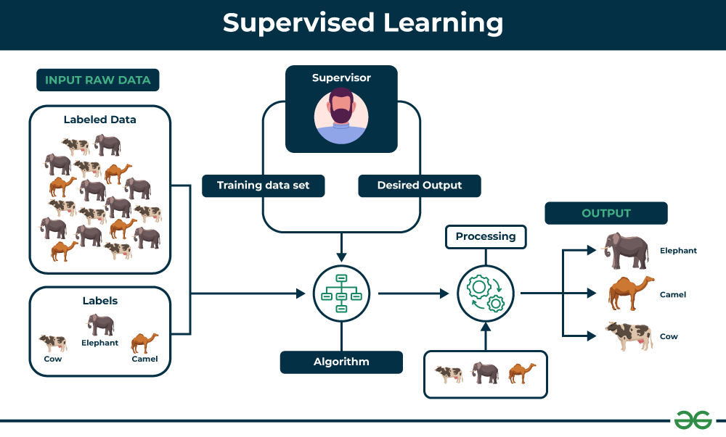

Slide 37
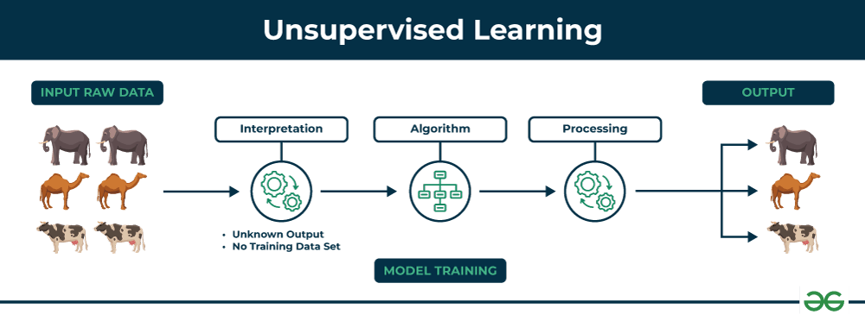

Slide 38
Example
Consider the following data regarding patients entering a clinic. The data consists of the gender
and age of the patients.

Slide 39
Some examples of supervised learning are
Predicting the results of a game
Predicting whether a tumour is malignant or benign
Predicting the price of domains like real estate, stocks, etc.
Classifying texts such as classifying a set of emails as spam or non-spam

Slide 40
There are two main categories of supervised learning that are mentioned below:
Classification :Where the output is a categorical variable (e.g., spam vs. non-spam emails, yes vs. no).
Regression : Where the output is a continuous variable (e.g., predicting house prices, stock prices).

Slide 41
Regression: This is a type of problem where we need to predict the continuous-response value (ex : above we predict number which can vary from -infinity to +infinity)
Some examples are :
• what is the price of house in a specific city?
• what is the value of the stock?
• how many total runs can be on board in a cricket game?etc… There are tons of things we can predict if we wish.

Slide 42
Classification: This is a type of problem where we predict the categorical response value where the data can be separated into specific “classes” (ex: we predict one of the values in a set of values).
Some examples are :
• this mail is spam or not?
• will it rain today or not?
• is this picture a cat or not?
Basically ‘Yes/No’ type questions called binary classification.
Other examples are :
• this mail is spam or important or promotion?
• is this picture a cat or a dog or a tiger?
This type is called multi-class classification.

Slide 43
Classification separates the data, Regression fits the data

Slide 44
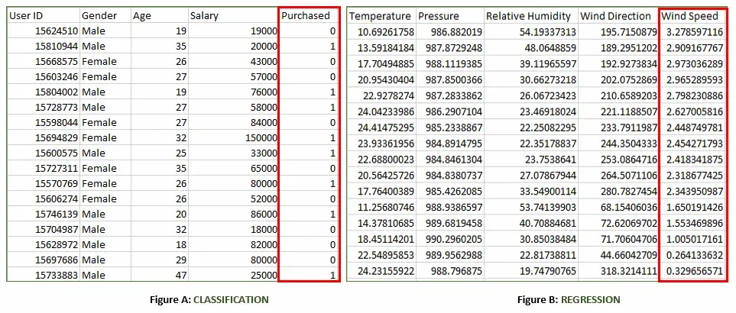

Slide 45
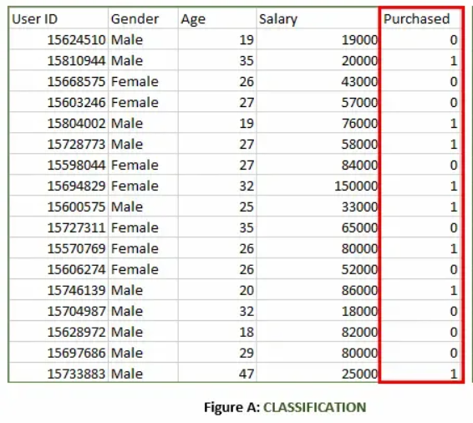
Figure A: It is a dataset of a shopping store that is useful in predicting whether a customer will purchase a particular product under consideration or not based on his/her gender, age and salary.
Input: Gender, Age, Salary
Output: Purchased i.e. 0 or 1; 1 means yes the customer will purchase and 0 means that the customer won't purchase it.

Slide 46
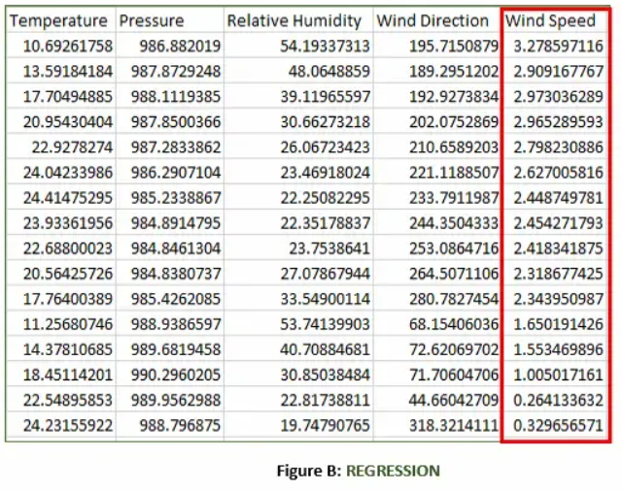
Figure B: It is a Meteorological dataset that serves the purpose of predicting wind speed based on different parameters.
Input: Temperature, Pressure, Relative Humidity, Wind Direction
Output: Wind Speed

Slide 47
Working of Supervised Machine Learning
The working of supervised machine learning follows these key steps:
1. Collect Labeled Data
Gather a dataset where each input has a known correct output (label).
Example: Images of handwritten digits with their actual numbers as labels.
2. Split the Dataset
Divide the data into training data (about 80%) and testing data (about 20%).
The model will learn from the training data and be evaluated on the testing data.
3. Train the Model
Feed the training data (inputs and their labels) to a suitable supervised learning algorithm (like Decision Trees, SVM or Linear Regression).
The model tries to find patterns that map inputs to correct outputs.
4. Validate and Test the Model
Evaluate the model using testing data it has never seen before.
The model predicts outputs and these predictions are compared with the actual labels to calculate accuracy or error.
5. Deploy and Predict on New Data
Once the model performs well, it can be used to predict outputs for completely new, unseen data.

Slide 48
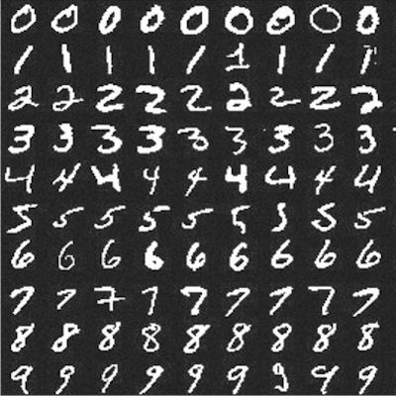
Handwritten Digit Recognition (HDR)

Slide 49
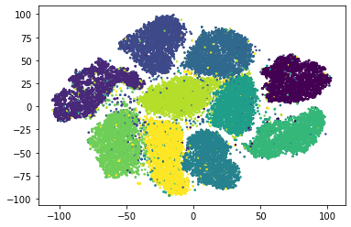

Slide 50
Splitting data into training, validation and testing dataset
- The training dataset (60%) is used to fit our models
- The Validation dataset (20%) is used to evaluate our models
- The Testing dataset (20%) is used to test our models
train_test_split() method returns us the training data, its labels and also the validation data and its labels.
For training a model, we initially split the model into 3 three sections which are :
- Training data – Validation data – Testing data.
You train the classifier or algorithm using Training data set, tune the parameters using validation data set
and then test the performance of your classifier on unseen test dataset.
Note: During training the classifier only the training and/or validation set is available.
The test set will only be available during testing the classifier.

Slide 51
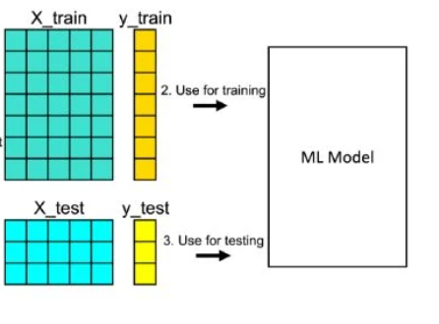
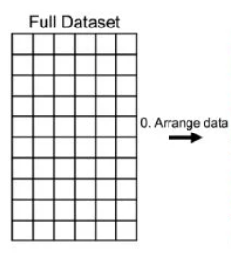
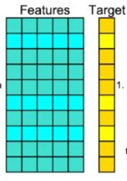
Application of train_test_split()
You need to import train_test_split() and NumPy before you can use them.
You can split both input and output datasets with a single function call:

Slide 52
KNN Algorithm – K-Nearest Neighbors Classifiers and Model Example
The K-Nearest Neighbors (K-NN) algorithm is a popular Machine Learning algorithm used mostly for solving classification problems.

Slide 53
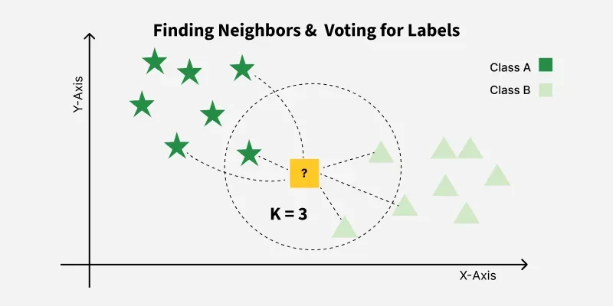
What is the KNN algorithm?
K-Nearest Neighbors (KNN) is a supervised machine learning algorithm generally used for classification but can also be used for regression tasks. It works by finding the "k" closest data points (neighbors) to a given input and makes a predictions based on the majority class (for classification) or the average value (for regression).

Slide 54
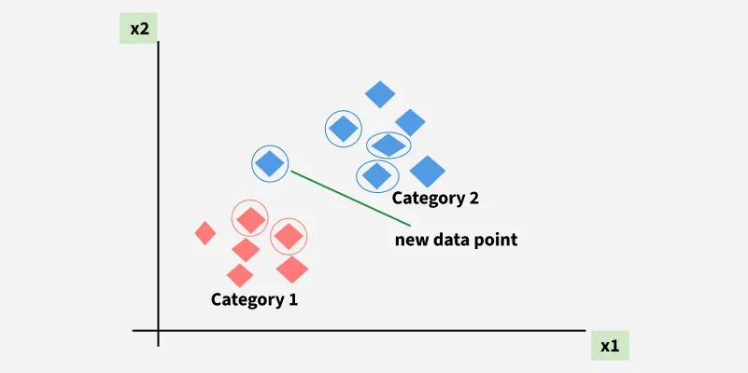
For example, consider the following table of data points containing two features:

Slide 55



Distance Metrics Used in KNN Algorithm
KNN uses distance metrics to identify nearest neighbor, these neighbors are used for classification and regression task. To identify nearest neighbor we use below distance metrics:
1. Euclidean Distance
2. Manhattan Distance
3. Minkowski Distance

Slide 56
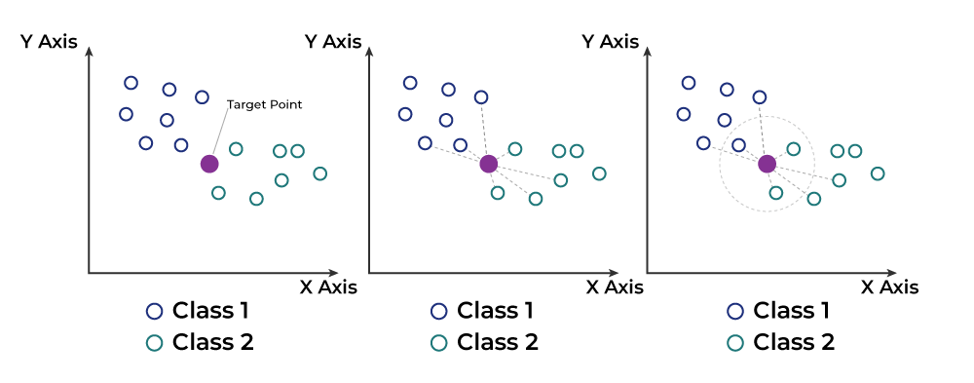
Working of KNN algorithm
Thе K-Nearest Neighbors (KNN) algorithm operates on the principle of similarity where it predicts the label or value of a new data point by considering the labels or values of its K nearest neighbors in the training dataset.

Slide 57
Based on its closeness or similarities in a given range (K) of neighbors, the algorithm assigns the new data to a class or category in the data set (training data).
Step #1 - Assign a value to K.
Step #2 - Calculate the distance between the new data entry and all other existing data entries (you'll learn how to do this shortly). Arrange them in ascending order.
Step #3 - Find the K nearest neighbors to the new entry based on the calculated distances.
Step #4 - Assign the new data entry to the majority class in the nearest neighbors. This called the majority voting.

Slide 58
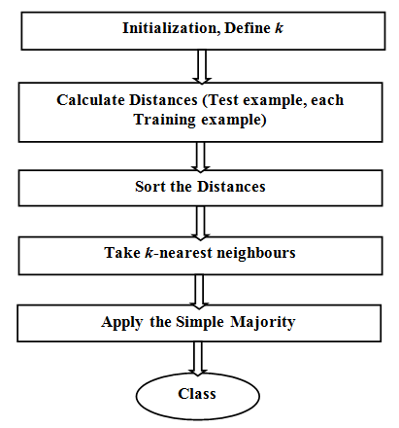
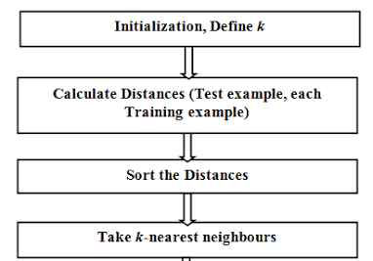

Slide 59
Advantages of KNN
Simple to use: Easy to understand and implement.
No training step: No need to train as it just stores the data and uses it during prediction.
Few parameters: Only needs to set the number of neighbors (k) and a distance method.
Disadvantages of KNN
Slow with large data: Needs to compare every point during prediction.
Struggles with many features: Accuracy drops when data has too many features.
Can Overfit: It can overfit especially when the data is high-dimensional or not clean.

Slide 60
Example: The table represents our data set. We have two columns — Brightness and Saturation. Each row in the table has a class of either Red or Blue.
Before we introduce a new data entry, let's assume the value of K is 5.
Brightness | Saturation | Class
40 | 20 | Red
50 | 50 | Blue
60 | 90 | Blue
10 | 25 | Red
70 | 70 | Blue
60 | 10 | Red
25 | 80 | Blue
Training set
Brightness | Saturation | Class
20 | 35 | ?
Testing set

Slide 61
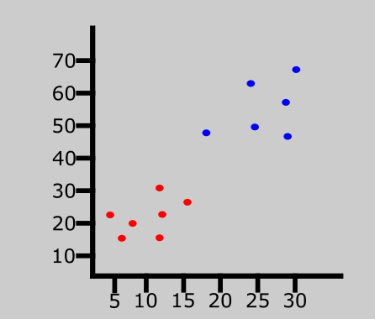
The graph represents a data set consisting of two classes: red and blue.

Slide 62
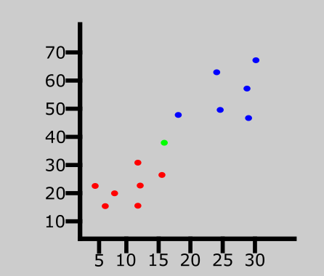
A new data entry has been introduced to the data set. This is represented by the green point in the graph.
Brightness | Saturation | Class
20 | 35 | ?

Slide 63
We have a new entry but it doesn't have a class yet. To know its class, we have to calculate the distance from the new entry to other entries in the data set using the Euclidean distance formula.
Distance #1
For the first row, d1:
d1 = √(20 - 40)² + (35 - 20)²
= √400 + 225
= √625
= 25
Brightness | Saturation | Class | Distance
40 | 20 | Red | 25
Distance #2
For the second row, d2:
Brightness | Saturation | Class | Distance
50 | 50 | Blue | 33.54
d2 = √(20 - 50)² + (35 - 50)²
= √900 + 225
= √1125
= 33.54

Slide 64
Here's what the table will look like after all the distances have been calculated:
Brightness | Saturation | Class | Distance
40 | 20 | Red | 25
50 | 50 | Blue | 33.54
60 | 90 | Blue | 68.01
10 | 25 | Red | 10
70 | 70 | Blue | 61.03
60 | 10 | Red | 47.17
25 | 80 | Blue | 45

Slide 65
Let's rearrange the distances in ascending order:
Brightness | Saturation | Class | Distance
10 | 25 | Red | 10
40 | 20 | Red | 25
50 | 50 | Blue | 33.54
25 | 80 | Blue | 45
60 | 10 | Red | 47.17
70 | 70 | Blue | 61.03
60 | 90 | Blue | 68.01
Since we chose 5 as the value of K, we'll only consider the first five rows. That is:
Brightness | Saturation | Class | Distance
10 | 25 | Red | 10
40 | 20 | Red | 25
50 | 50 | Blue | 33.54
25 | 80 | Blue | 45
60 | 10 | Red | 47.17
As you can see, the majority class within the 5 nearest neighbors to the new entry is Red. Therefore, we'll classify the new entry as Red.

Slide 66


Slide 67
How to Choose the Value of K in the K-NN Algorithm
There is no particular way of choosing the value K, but here are some common conventions to keep in mind:
Choosing a very low value will most likely lead to inaccurate predictions.
The commonly used value of K is 5.
Always use an odd number as the value of K.

Slide 68
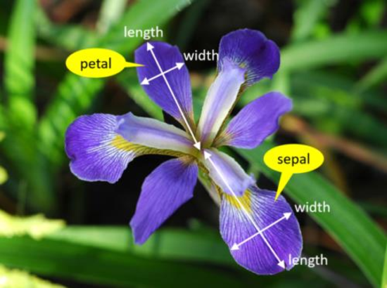

Slide 69
Under and overfitting
A key element is the interplay between the capacity of the model, that is its flexibility and ability to fit diverse data, and the amount and quality of the training data. When the capacity is insufficient, the model cannot fit the data, resulting in a high error during training. This is referred to as underfitting.
On the contrary, when the amount of data is insufficient, as illustrated in Figure 1.2, the model will often learn characteristics specific to the training examples, resulting in excellent performance during training, at the cost of a worse fit to the global structure of the data, and poor performance on new inputs. This phenomenon is referred to as overfitting.

Slide 70
Testing and evaluating model performance
After training, the model is tested on an independent test data set to evaluate its performance objectively.
At this stage, it is necessary to input test data into the model that has actual target values so you can compare the model’s predictions with the exact values. Standard evaluation metrics include:

Slide 71
3. Model Deployment
Once a machine learning model is trained, the next step is deploying it within a business application, such as a mobile or desktop app. This involves integrating the model into existing software, ensuring it can process real-world data and make accurate predictions. Deployment isn't just about having a well-trained model—it must seamlessly integrate into the environment, scale effectively, and remain reliable over time. The ultimate goal is transitioning from an experimental model to a fully operational system that delivers consistent, real-world predictive power.

